Slide 1
C24 Installation and Activation
PowerSeries with C24-HUB
Rev 101

Slide 2
Agenda
Overview of installation process for:
DSC Power Series 1864 + C24-HUB
This overview assumes previous Life Safety installer training for the DSC PowerSeries security panel
https://portal.c24manager.com/activation

Slide 3
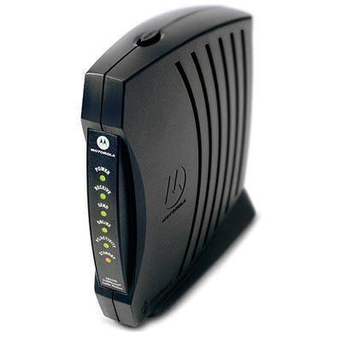
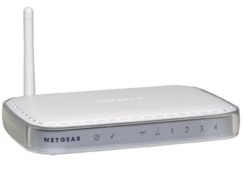
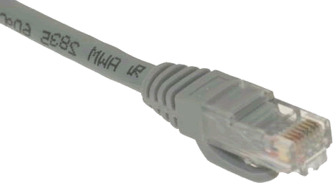
Before You Begin
Find the customer’s Home Router (REQUIRED)
Gather all products, tools and info near there
Connect an Ethernet cable to available port on Home Router (ONE open port is required)
Ethernet to:
Home Router
Broadband
Modem

Slide 4
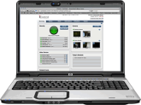
Installation Steps: SAAIT
1. Secure
Setup Security
HUB
to Network
HUB to Panel
Components
to Power
Create
Site
Owner
2. Activate
Activate
HUB
Add IP Devices
Touch Screen Cameras
Add
Z-Wave
Devices
3. Add
Check Devices
Physically Install
Devices
4. Install
Test
Whole
System
5. Test
Teach
Customer

Slide 5
Secure
Setup Security
HUB
to Network
HUB to Panel
Components
to Power
1. Secure
Components
to Power
Physically prepare the PowerSeries for LifeSafety functionality (installation, battery, power, programming)
Connect C24-HUB to Network and Panel
Power Up and ensure proper connections/operations

Slide 6
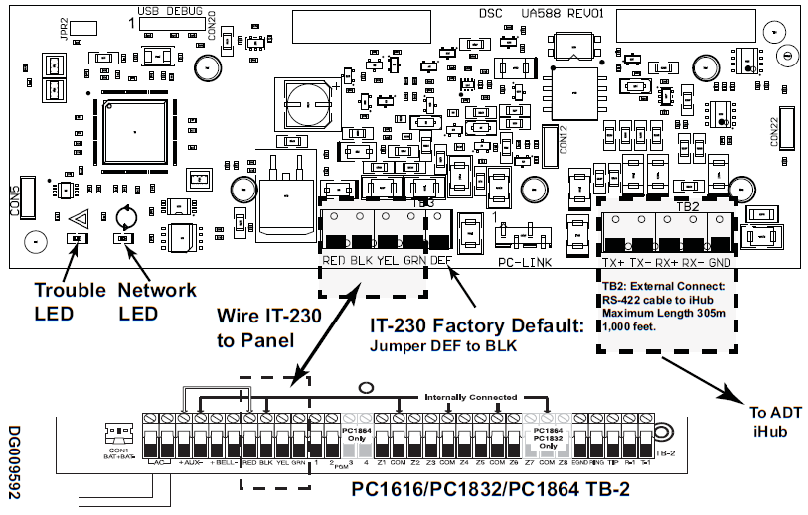
Panel Wiring
RS-422 cable to HUB.
Maximum Length 305m 1,000 feet
Connect PC-LINK to Panel PC-LINK with included cable
4-wire KEYBUS
To C24-HUB
Note: IT-230 shown. Terminal strip is the same on all RS-422 modules

Slide 7
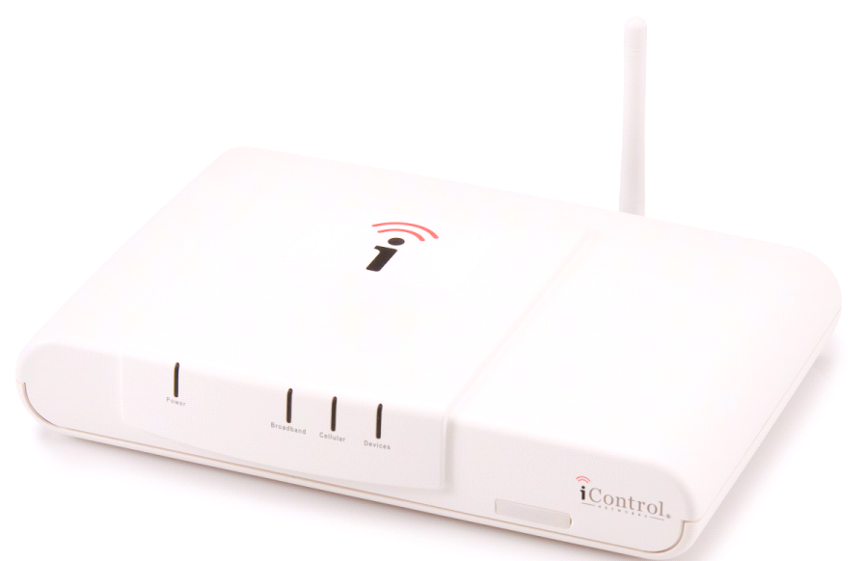
C24-HUB Hardware
LEDs
Ports/Connector
The Broadband port
connects to an open port on Customer’s Router.
Reset Button is used to factory default the HUB.
LAN Port for adding Wi-Fi devices (Camera, Touchscreen)
RS-422 Connection from the Panel

Slide 8
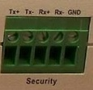
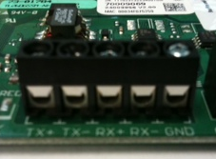
HUB to Panel
Security Connection- RS 422
Panel | HUB
Tx- Rx-
Tx+ Rx+
Rx- Tx-
Rx+ Tx+

Slide 9
Required Programming
Section [382] turn option 5 ON
This option enables communication between the panel and the RS-422 module
All programming has been defaulted and no additional programming is needed
Broadcast zone labels when using RFK5500 or PK5500 keypad
After RS-422 is connected, send zone labels to module
Access keypad programming [*][8] [installer’s code] [*] [998] [*] to perform broadcast
Download of zone labels can also be done with DLS

Slide 10
Panel Verification
Verify RS-422 module connected properly
Enter Section [851] and sub-section [672]
Multiple beeps heard if good communication
Long tone if bad communication
Diagnostics
Ensure option 5 in section [382] is enabled
Check orientation of 4-pin PC-LINK connector
Check connection of 4-wire KEYBUS
Recalculate power consumption

Slide 11
Optional Programming
To access optional programming enter section [851]
[671] Lifestyle Event Toggle (Should be left at default)
Disable buffering of event groups
Buffer is used when RS-422 communication is lost
[672]-[679] Lifestyle Zone Toggle Options
Disable status reporting of zones (Open/Close Zones)
[681] Notification Event Toggle
Disable system event reporting (Troubles, Faults, etc.)
[682]-[689] Notification Zone Toggle Options
Disable lifestyle reporting codes (Alarm reporting codes)

Slide 12
Activate
Create
Site
Owner
2. Activate
Activate
HUB
Activation process done through web portal
Follow the Wizard
Register HUB with activation key
Create a new user account or attach new site to existing user

Slide 13
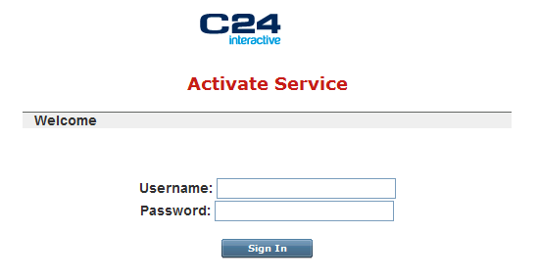
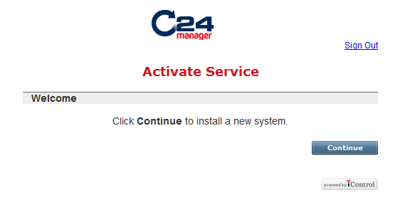
Activation Sign In

Slide 14
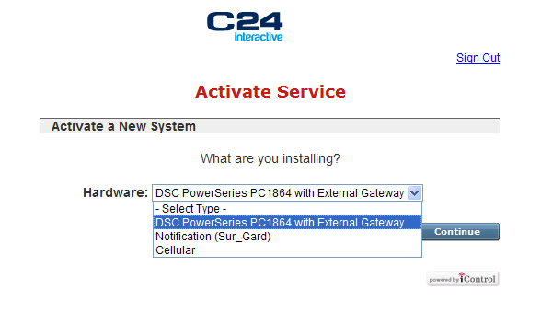
Activation Process
Select Site Type
Enter Activation Key

Slide 15
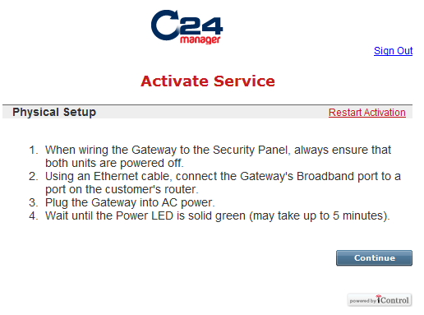
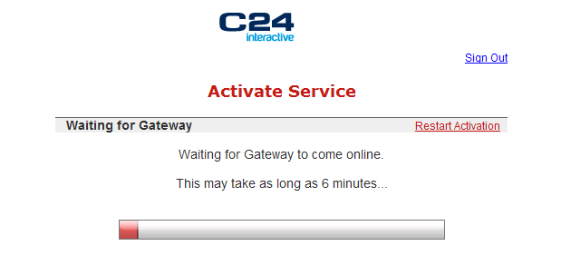
Activation Process
Note: The Restart Activation Iink will delete the site at the server
Note: If new HUB firmware is available it will automatically be upgraded once online

Slide 16
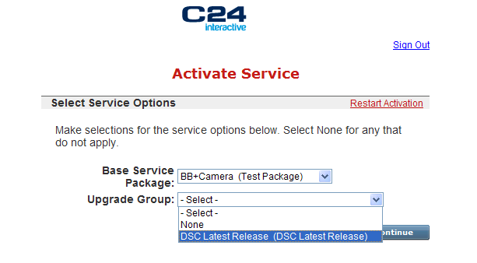
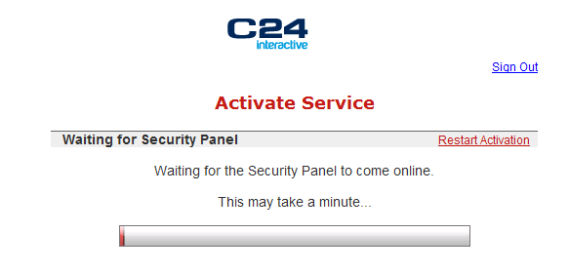
Activation Process
Select Service Options
Waiting for the Security Panel to come online
Note: If new panel or module firmware is available it will automatically be upgraded once online, panel MUST be in Ready State.

Slide 17
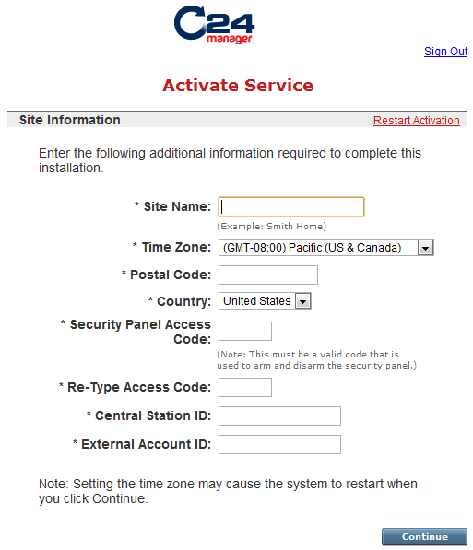
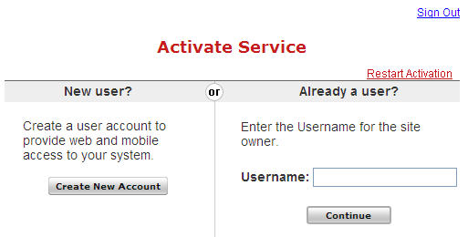
Owner Registration
Create New User or attach site to Existing

Slide 18
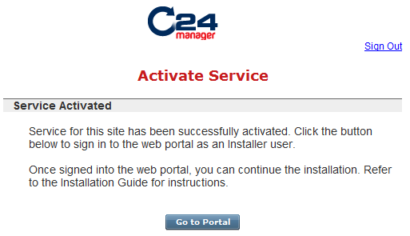
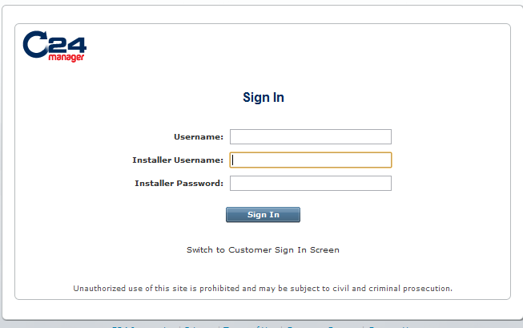
Site Creation Complete

Slide 19
Add
Add IP Devices
Touch Screen Cameras
Add
Z-Wave
Devices
3. Add
Begin using the Web Portal
Add Wi-Fi LifeStyle Devices using the Portal
Touch Screen
Video Cameras
Add Z-Wave LifeStyle Devices using the Portal
Thermostats, Lighting modules

Slide 20
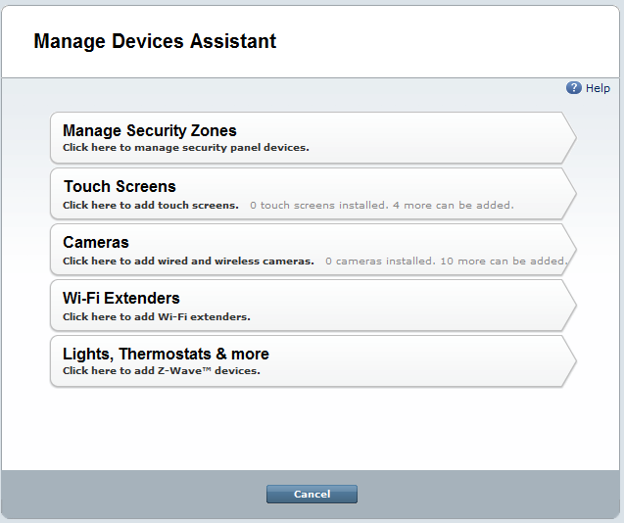
Managing Devices

Slide 21
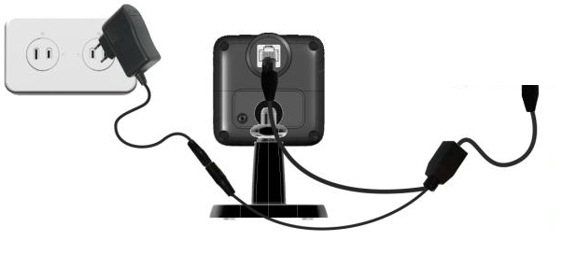
Adding a Camera
Connect an Ethernet cable from the LAN/Device port to the back of camera via the Y-cable
Power up the camera (12VDC 1A)
Wait for Power and Network LEDs to turn solid green
Follow the Manage Device Wizard
To HUB LAN port
Y-Cable

Slide 22
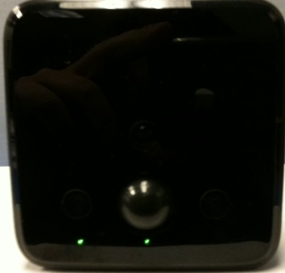
Adding a Camera
Network LED
On Green – LAN/Wireless connection established
Off – No active connection to the LAN port
Power LED
On Green – Power On
Network
Power

Slide 23
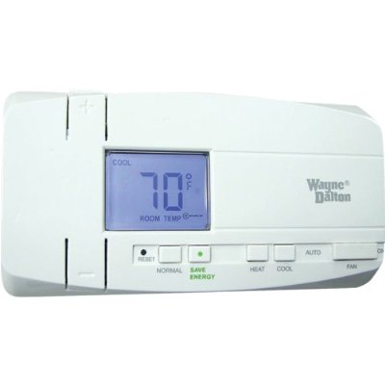
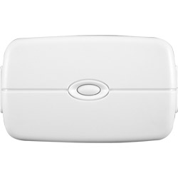
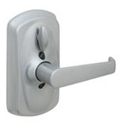
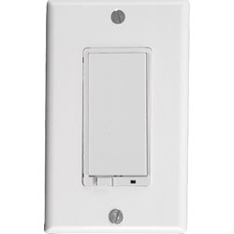
Adding Z-Wave Devices
Power up the device within 15 ft of the HUB
Follow the Manage Device Wizard
Note different devices may be ‘triggered’ differently. Be sure to refer to the device manual for ‘triggering’ the device enrollment.

Slide 24
Install
Check Devices
Physically Install
Devices
4. Install
Confirm proper device operation via the Web Portal
Install LifeStyle devices in their proper location, paying attention to range limits
Wi-Fi Devices < 50 feet from the HUB
Z-Wave Devices < 60 feet from nearest other Z-Wave device
Be sure to Relearn Z-wave network through ‘Diagnostics’

Slide 25
Test
Test
Whole
System
5. Test
Teach
Customer
Check Web portal for sensor activities
Run Diagnostics
Set the System to active in the Web Portal
Review functionality with customer

Slide 26
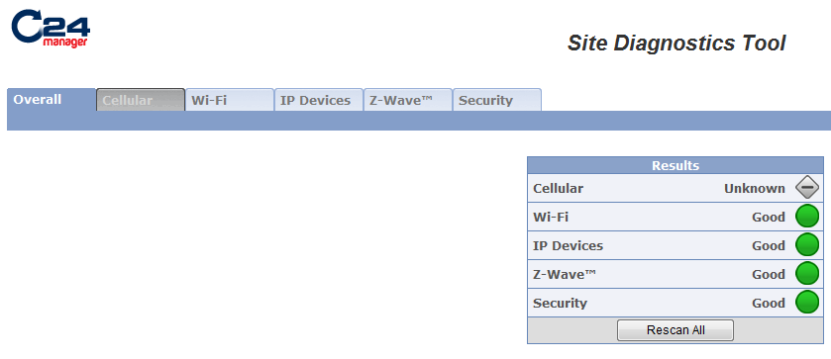
Diagnostics
Running Diagnostics will automatically scan all technologies and indicate any concerns/errors

Slide 27
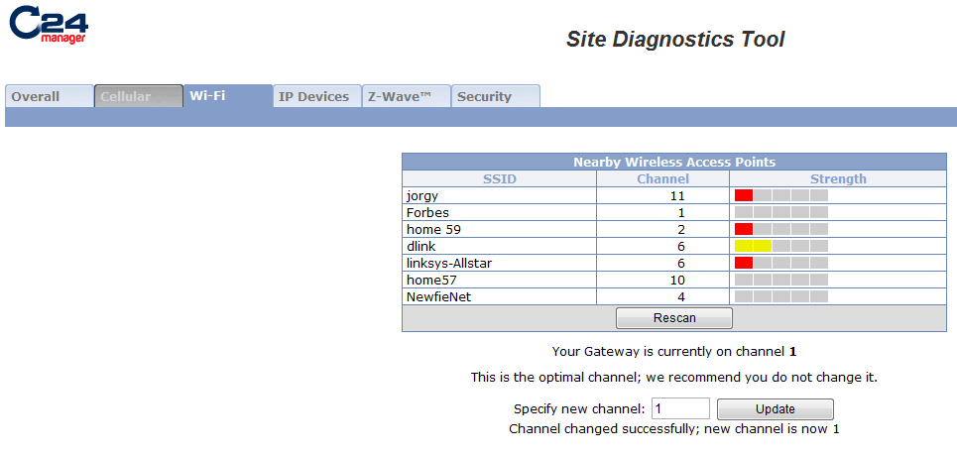
Diagnostics
‘Wi-Fi ‘will indicate all wireless networks within range of the HUB
Note it may recommend the HUB be changed to a different channel

Slide 28
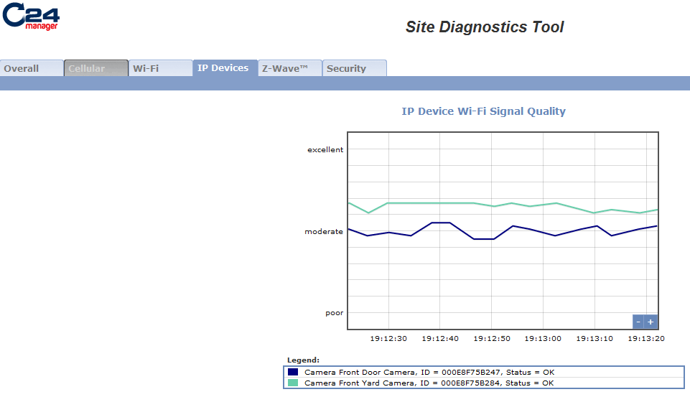
Diagnostics
‘IP Devices’ will indicate the signal strength of cameras and touchscreens

Slide 29
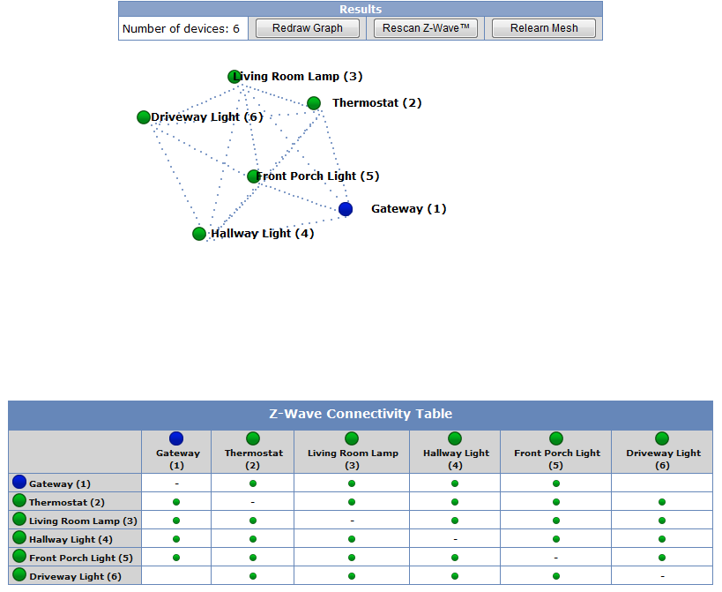
Diagnostics
‘Z-Wave’ will display the Mesh Network topology
‘Relearn Mesh’ will reset the entire network and recreate a new ‘Mesh’
‘Rescan Z-Wave’ will check status of all connected devices

Slide 30
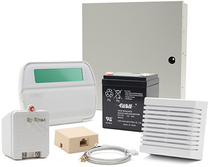
Teach Customer
Life Safety
Security Panel / Keypad
Sensors
Arm
Disarm
Emergency Buttons
Change/Program Acess Code
KeyFob
Arm/Disarm
Panic

Slide 31
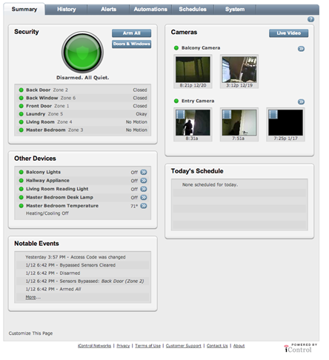
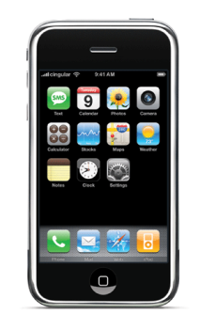
Teach Customer
Web Portal
Test from customer’s computer, not yours!!
Verify customers welcome email
activate the login account
Bookmark URL
Tabs: Summary, History, System
Description one line or less
Add more users
Set up alert, automation, and schedule
Online web portal help
Mobile Portal and Application
Check the kind of phone
Where to download the applications (iPhone, Android)
Or Mobile html (It’s a “thin” version of web portal)

Slide 32
Thank You

